Slide 1

Property Price & School catchment zone
Suja Kattazhath

Slide 2
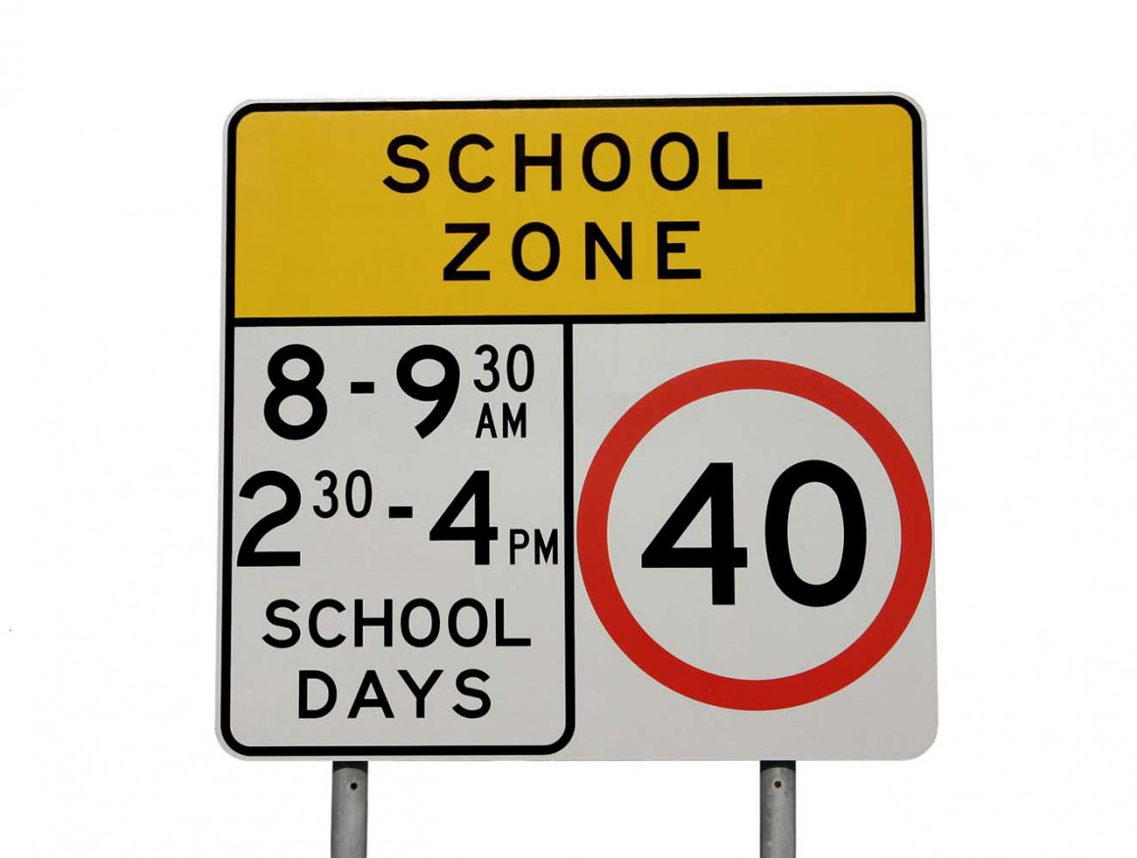
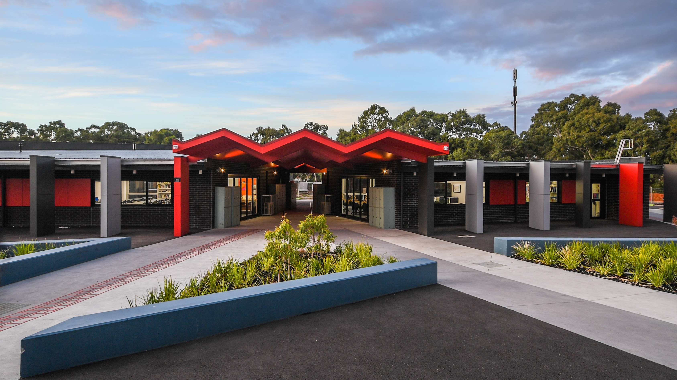
Agenda
Project Overview
Data
School Catchment Zone and Property Prices
Models
Findings
Risks and Limitations
Next Steps
Conclusion

Slide 3


Project Overview
How school zones are affecting property prices
When the kids start to grow up and education becomes a priority, buying property in a school catchment zone is essential. However, suitable homes around Melbourne's best schools can be expensive. This project is analyzing the correlation between School zone ranking and property pricing using Victorian government school data and the recent housing pricing data.
What is a school catchment?
A school catchment area is defined as the geographical location where a state school’s core intake of students must live. As public schools have defined local enrolment areas, a child is entitled to enroll in a particular school based on his or her residential address. Every public school reserves enough places within their school for students in their local enrolment area.

Slide 4
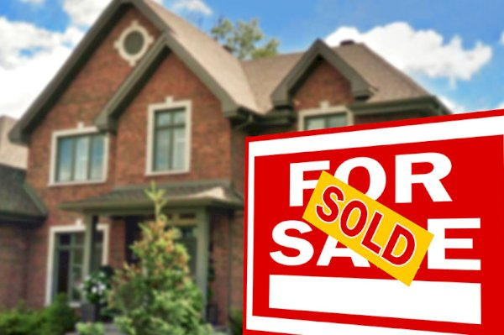
Data
School Data :
Victorian Government School Zones 2020
(Source : https://discover.data.vic.gov.au/)
Victorian Government School locations (Source : https://discover.data.vic.gov.au/)
School Ranking. (https://www.topscores.co/index.php?about)
Housing Data : 3 years of housing data from Melbourne
(Source : https://www.kaggle.com)

Slide 5
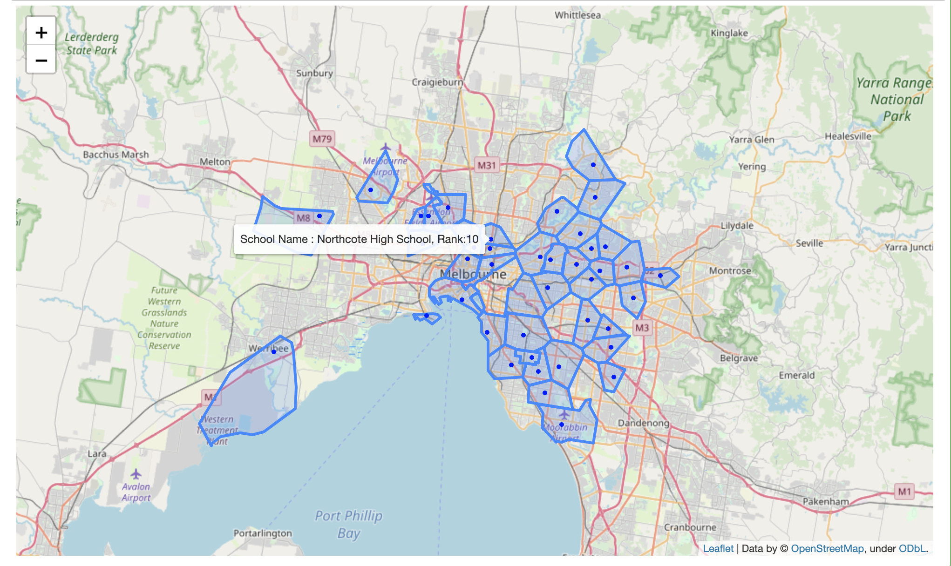
School Catchment Zone and Prices
Melbourne Public School zone areas – interactive map
School catchment zones are identified using longitude and latitude.

Slide 6
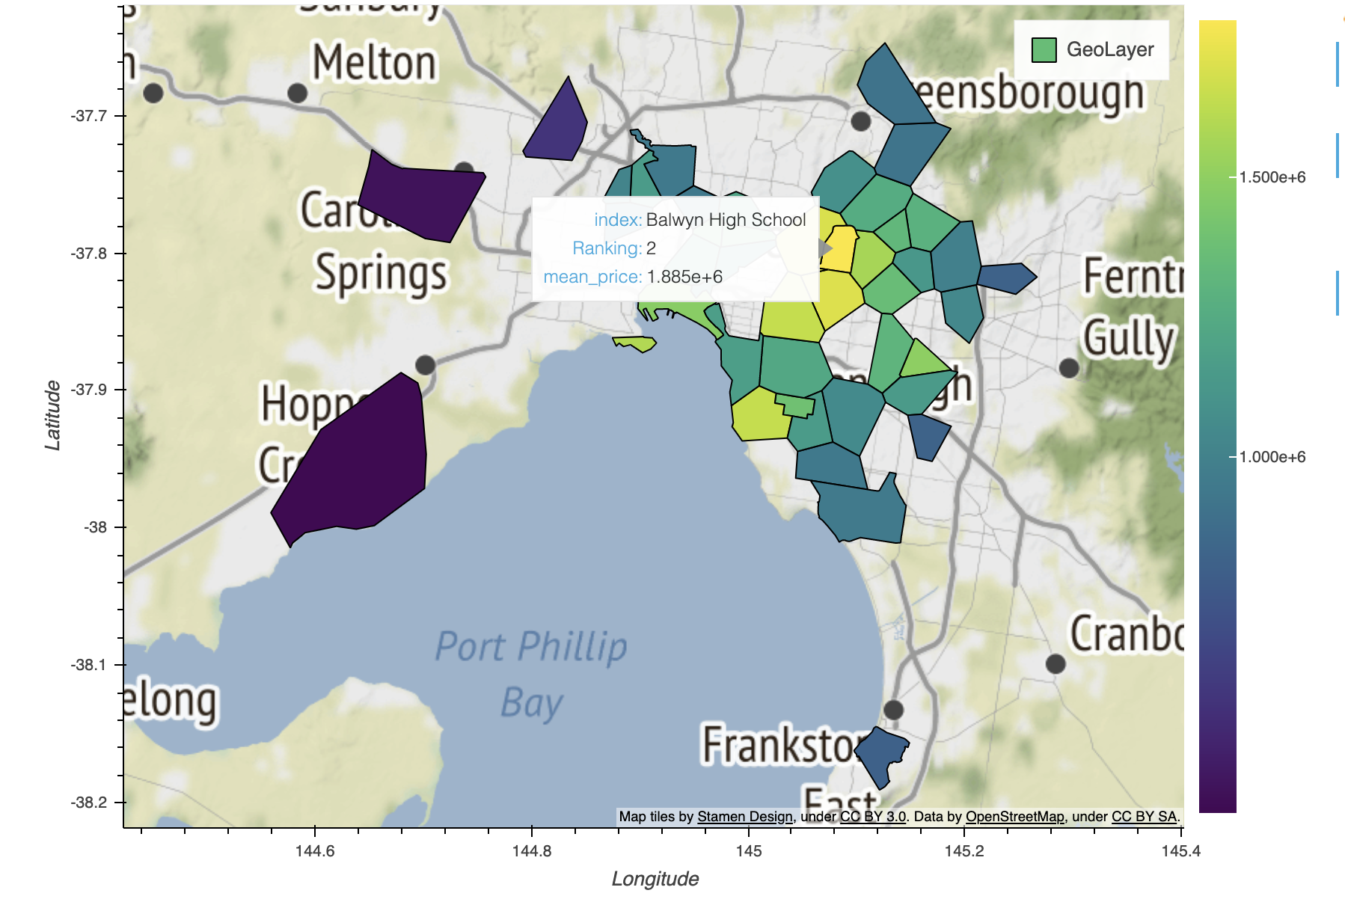
School Catchment Zone and Prices
Melbourne Public School zone areas – interactive map

Slide 7
Models
Property Price –Predictive models

Slide 8
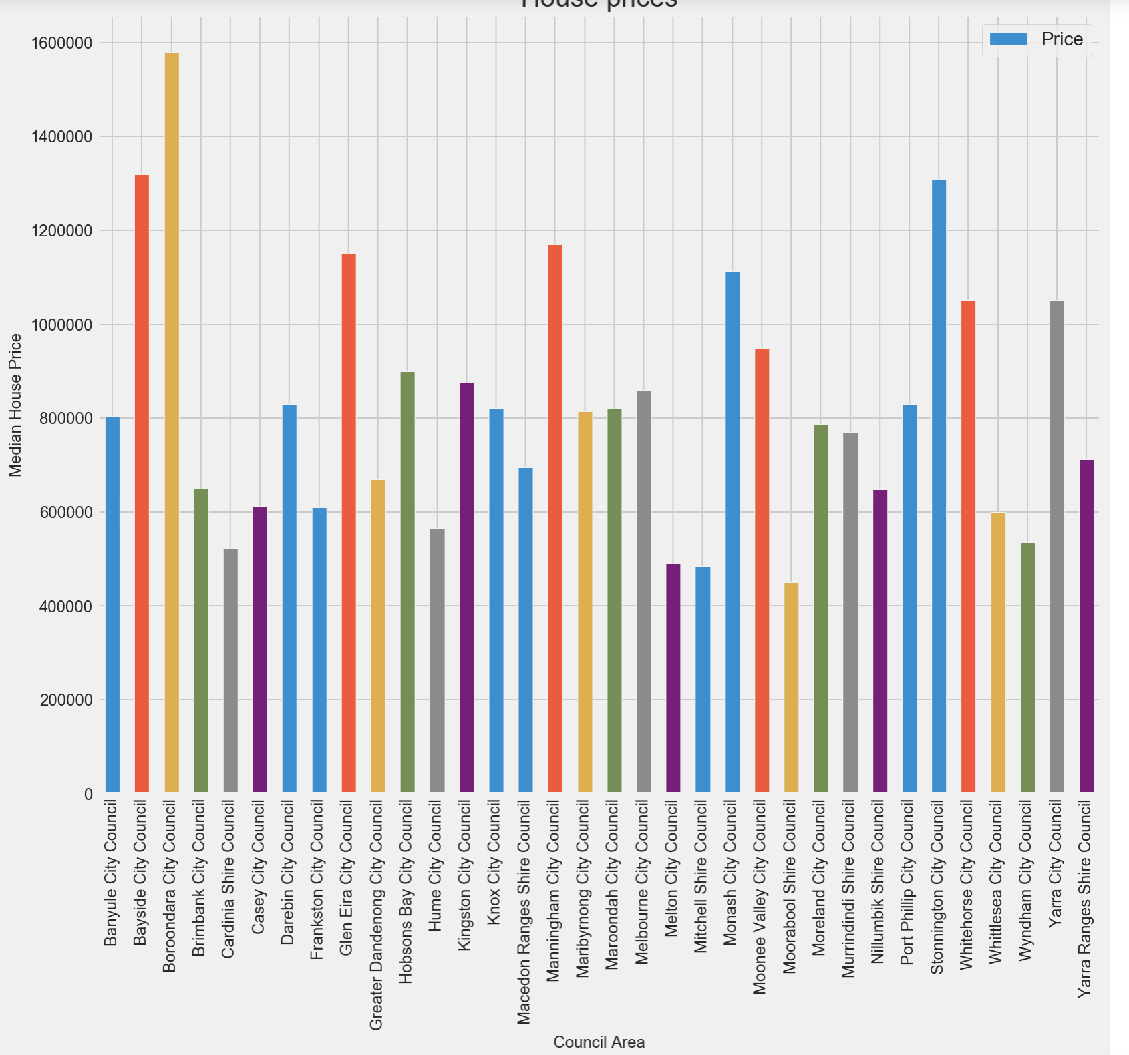
Findings
Median House Prices –By Council
sss

Slide 9
Findings
Melbourne Public School ranking and median prices
School catchment zones are identified using longitude and latitude.
School ranking and median price are highly correlated. However there are some exceptions are can be identified. e.g. Camberwell vs Balwyn ( Other factos proximity , historical price, metro area etc.)

Slide 10
Risks and Limitations
Completeness of Housing data
Missing values
Changing catchment area

Slide 11
Next Steps
Melbourne Public School ranking and median prices
Re-train the model
Build multiple models
Re-train the pricing model

Slide 12
Conclusion
Help parents for decision making for buying properties in school zones
Investors can potentially look to buy properties in school zones
Identity the boundaries of school zones and compare the prices
Cost of moving between school catchment areas

Slide 13
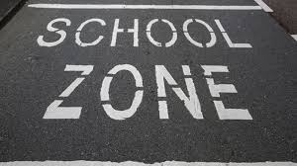
Thank You.
Suja Kattazhath
Suja.r.menon@gmail.com

